Slide 1

MY DEAR STUDENTS

Slide 2

Rahima begum academy. Allardarga,kushtia
TEACHER IDENTITY
Md. Raziul haque
Assistant teacher.
. MOB no-01740972512
. email-mdraziulhaque@gmail.com

Slide 3

For class – SIX :------
Total students---------
Absent students- -------
Subject- ENG 1ST
TIME-45 MINUTES
RAHIMA BEGUM ACADEMY
Allardarga, Daulatpur, Kushtia

Slide 4

LEARNING OUTCOMES
BY THE END OF THE LESSON
Students will be able to tell what is sentence.
Students will be able to write the structure of sentences.
Students will be able to write the 5 kinds of sentence.
Students will be able to tell how many kinds of sentence.

Slide 5

How are you students ?
What was I discussed in my previous clas?

Slide 6
Lesson declaration
lets see something
in
football
play
the field
we
we
play
football
in
the field
what is this ?
sentence
so today I will discuss about sentence

Slide 7
what is sentence?
A sentence is a group of words giving a complete thought. A sentence must contain a subject and a verb
A sentence is a set of words that is complete in itself, typically containing a subject and predicate, conveying a statement, question, exclamation, or command, and consisting of a main clause and sometimes one or more subordinate clauses. Oxford Dictionary

Slide 8
How many kinds of sentence?
There are five kinds of sentence
1
Assertive sentence
2
Interrogative sentence
3
Imperative sentence
4
Optative sentence
5
Exclamatory sentence

Slide 9

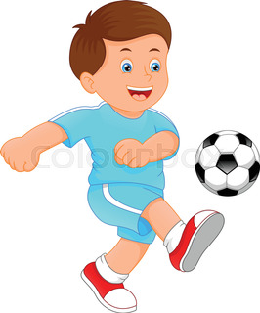
Let us discuss about assertive
structure
sub+
verb+
obj
collecting honey
A bee collects honey
A baby plays football
Playing football

Slide 10



Let us discuss about interrogative
structure 1.
a.v
sub
obj
is it int. mark ?
interrogation mark
structure 2.
wh
a.v
sub
verb
obj
what is the boy doing now ?

Slide 11
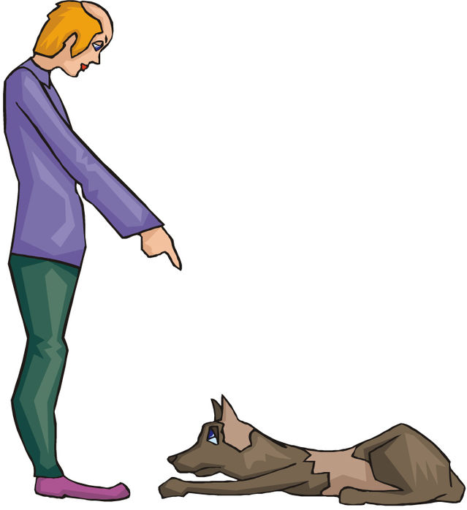

Let us discuss about imperative
structure
verb
obj
command
sit
down
advice
Do not tell alie

Slide 12

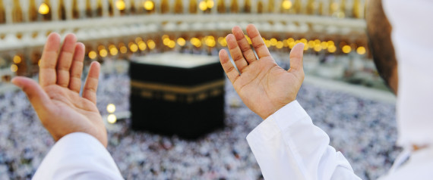
Let us discuss about optative
structure
may/might
sub
verb
obj
wish
May you get golden A+
pray
May Allah bless you

Slide 13

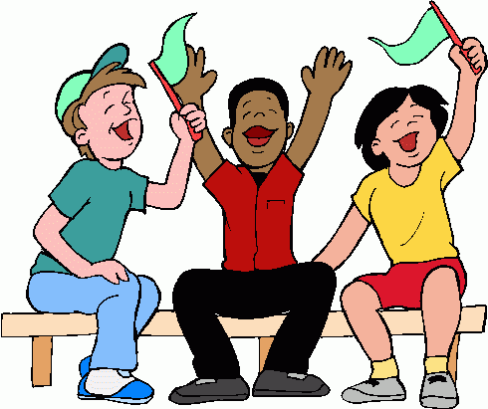

Let us discuss about exclamatory
structure
what a/an
adj
noun
sub
a.v/v +!
woh
what a nice dress it is !
hurrah
we have won the game!
sad
Alas! he has failed in the exam

Slide 14
To be continue
To be continue
To be continue
To be continue
To be continue

Slide 15

Good Bye
students

Slide 16





